Slide 1
Fill in the blanks and complete the table below:
– A system of values with a base of . Each unit is increased by the of 16.
16
Hexadecimal
power
 |  | Binary
Denary | Hexadecimal | 8 | 4 | 2 | 1
0 | 0
1
2 | 2
 | 3
4 | 4
5
6 | 6
7 | 7
 | 8
9 | 9
10 | A
11
 | C
13 | D
15 | F

Slide 2
Convert the Hexadecimal values into Binary.
HEX
RGB
Binary
F
8 | 4 | 2 | 1
F
8 | 4 | 2 | 1
0
8 | 4 | 2 | 1
0
8 | 4 | 2 | 1
0
8 | 4 | 2 | 1
0
8 | 4 | 2 | 1
HEX
RGB
Binary
0
8 | 4 | 2 | 1
0
8 | 4 | 2 | 1
F
8 | 4 | 2 | 1
F
8 | 4 | 2 | 1
0
8 | 4 | 2 | 1
0
8 | 4 | 2 | 1
HEX
RGB
Binary
2
8 | 4 | 2 | 1
0 | 0
C
8 | 4 | 2 | 1
F
8 | 4 | 2 | 1
F
8 | 4 | 2 | 1
F
8 | 4 | 2 | 1
F
8 | 4 | 2 | 1
HEX
RGB
Binary
F
8 | 4 | 2 | 1
E
8 | 4 | 2 | 1
2
8 | 4 | 2 | 1
A
8 | 4 | 2 | 1
4
8 | 4 | 2 | 1
D
8 | 4 | 2 | 1
HEX
1AF
9B2
4CF
0DB
8 | 4 | 2 | 1
8 | 4 | 2 | 1
8 | 4 | 2 | 1

Slide 3
Hexadecimal (Base 16) >>> Denary
 | 16^3 | 16^2 | 16^1 | 16^0
 | 4096 | 256 | 16 | 1
 | 16 | 1
 | B | F
Convert
Multiply
Total
 | 256 | 16 | 1
 | 2 | D | 3
Convert
Multiply
Total
 | 256 | 16 | 1
 | C | F | A
Convert
Multiply
Total
 | 4096 | 256 | 16 | 1
 | 1 | B | C | E
Convert
Multiply
Total

Slide 4
Hex | F | F | 0 | 0 | 0 | 0
Binary | 1111 | 1111 | 0000 | 0000 | 0000 | 0000
1) Why do programmers prefer to read Hexadecimal values rather than Binary Values?
Denary >>> Hexadecimal (Base 16)
Multiples of 16
16 | 32 | 48 | 64 | 80 | 96 | 112 | 128 | 144 | 160 | 176 | 192
Division |  |  | Working Out | Remainder | Hex
12040 | 16 | 752 |  | 8 | 8
752 | 16 | 47 |  | 0 | 0
47 | 16 | 2 |  | 15 | F
2 | 16 | 0 |  | 2 | 2
0
0
7
5
2
16
1
12
8
4
R8
1 2 0 4 0
4
7
7
R0
16
11
7 5 2
2
R15
16
4
4 7
0
R2
16
2
Hexadecimal
2F08

Slide 5
Division |  |  | Remainder | Hex
19840 | 16
 | 16
 | 16
 | 16
Hex
4D80
Division |  |  | Remainder | Hex
6574 | 16
 | 16
 | 16
 | 16
Hex
Division |  |  | Remainder | Hex
55555 | 16
 | 16
 | 16
 | 16
Hex
Division |  |  | Remainder | Hex
7583 | 16
 | 16
 | 16
 | 16
Hex

Slide 6
Represent numbers stored in registers and main memory as hexadecimal
An 8 Bit Register is used to show the condition of all four components in a chemical process. 1 - On, 0 - OFF
Pump A
OFF
Pump B
OFF
Cooler
OFF
Heater
OFF
Pump A
ON
Pump B
ON
Cooler
ON
Heater
ON
Write the contents of the 8 Bit Register if the following conditions occurred?
A) Pump A & B are OFF, Cooler & heater are ON
B) Pump A & B are ON, Cooler & heater are OFF
C) Pump A and heater is only ON
A)
Binary
Hexadecimal
B)
Binary
Hexadecimal
C)
Binary
Hexadecimal

Slide 7
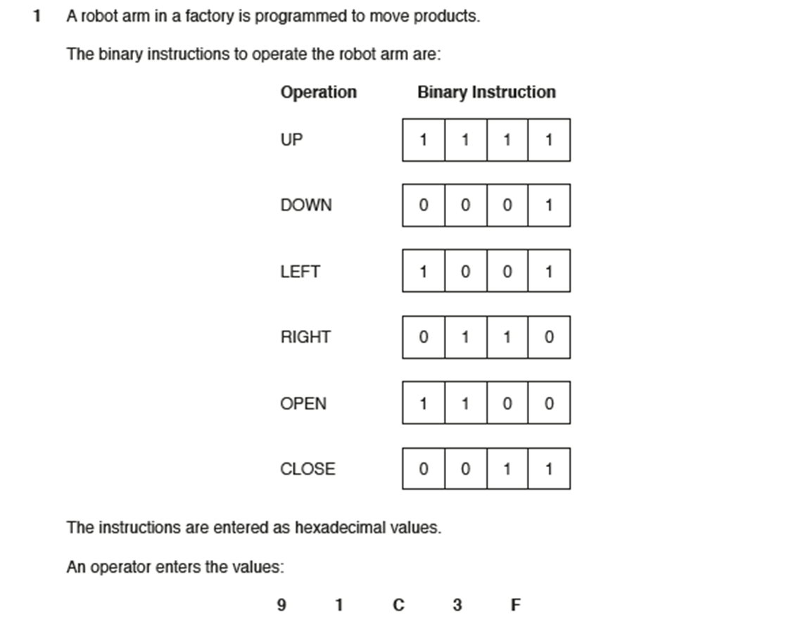
Exam Question
9
Convert the Values and write down the operation (e.g. RIGHT) carried out by the robot arm.
9 | Left
1
C
3
F

